Slide 1

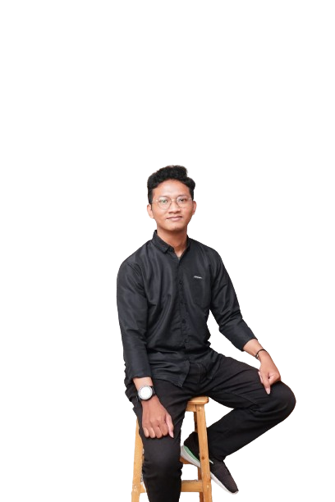

P O R T F O L I O
ADITYA SAPUTRA

Slide 2



P A G E 0 1
ABOUT ME
I am Aditya Saputra with experience in database management courses. Proficient in operating Microsoft Office, Canva, and Database Applications MySQL and Oracle, as well as having a keen interest in adapting to the developments in the Information and Communication Technology Industry.

Slide 3

P A G E 0 2
EDUCATION
2018 - 2021
SMA
LULUS
2021 –
GUNADARMA UNIVERSITY
STUDENT

Slide 4
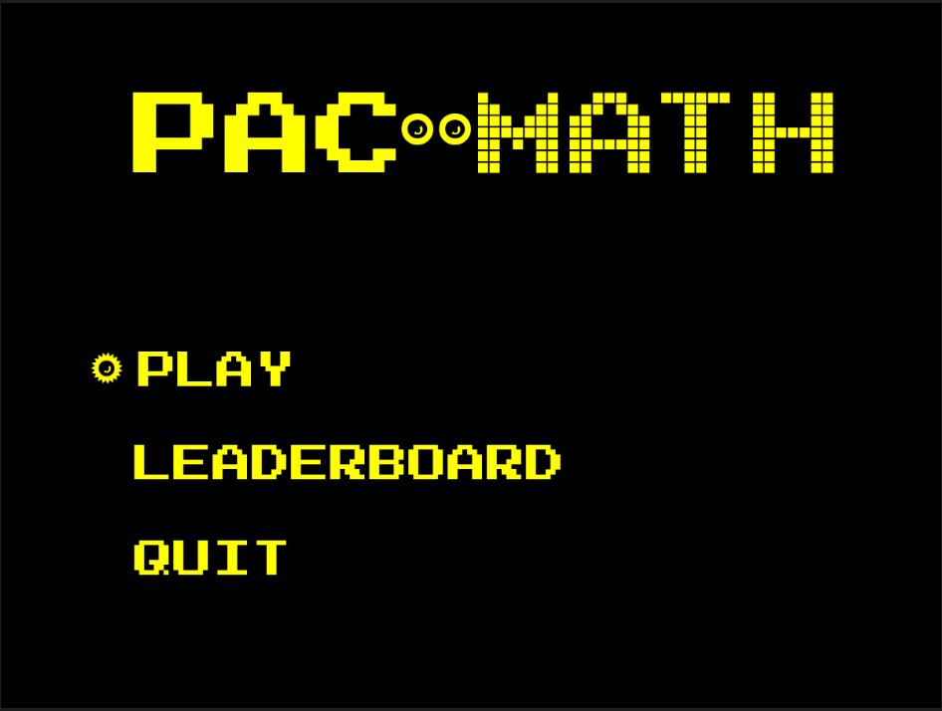
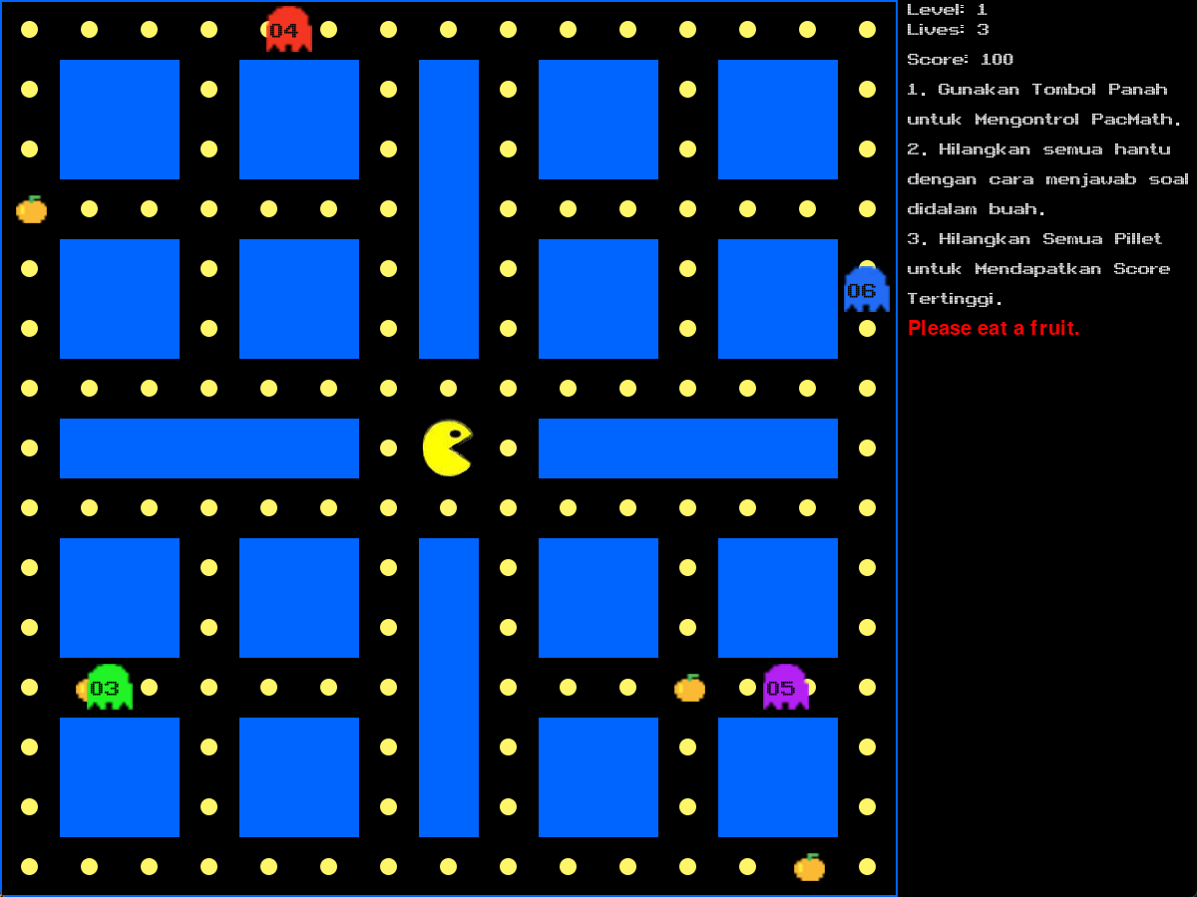


MY PROJECT
P A G E 0 3
Creation of educational game "PacMath"

Slide 5
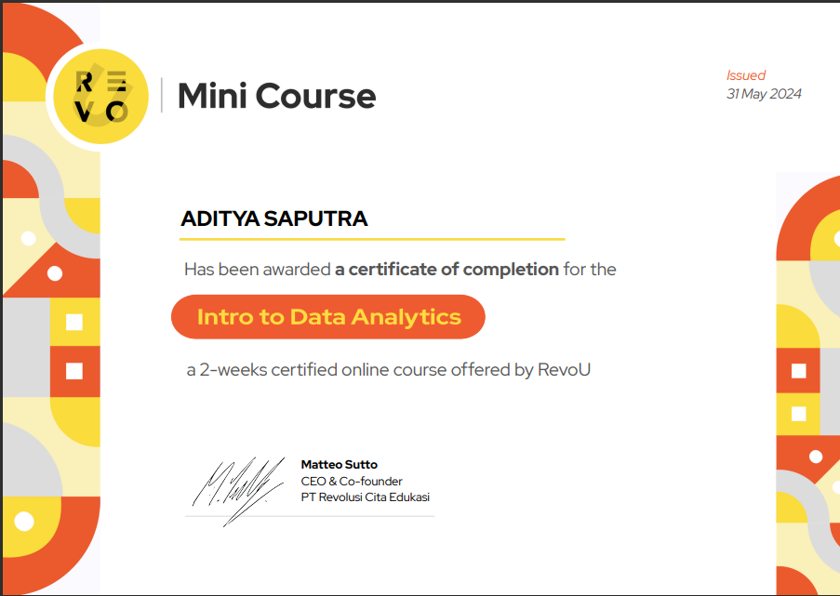
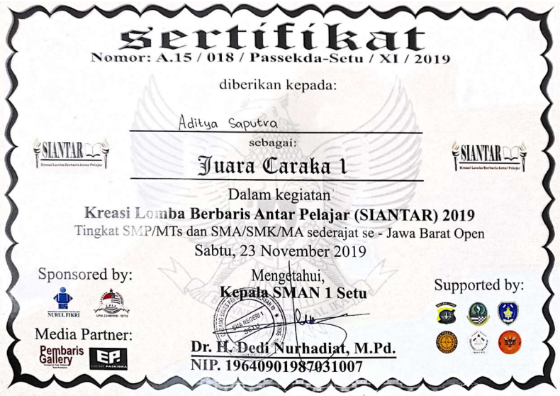
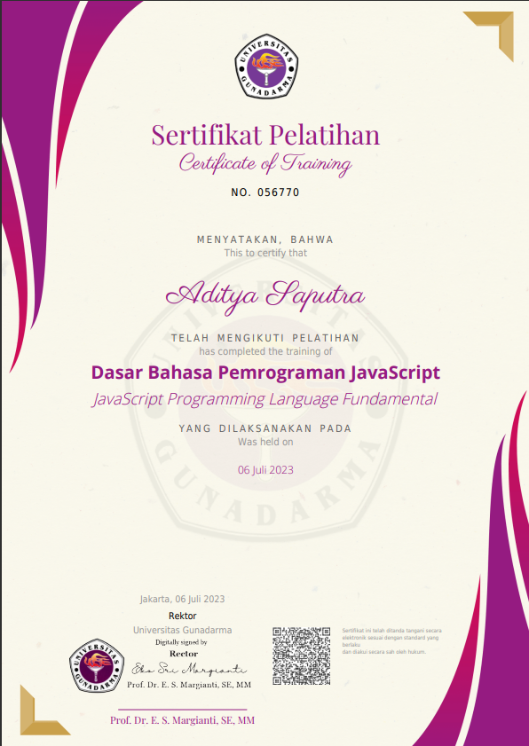
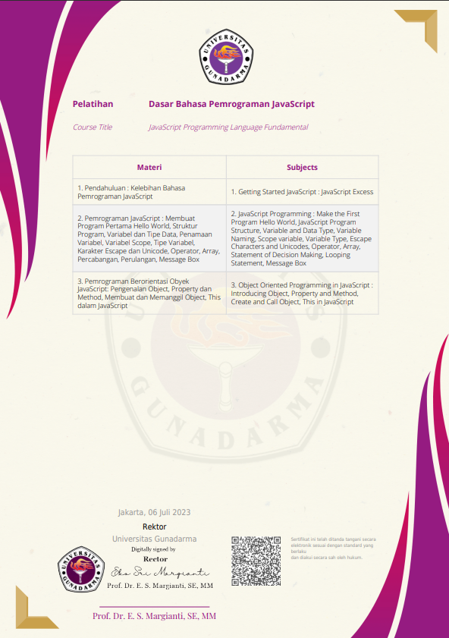
MY EXPERIENCE TRAINING
P A G E 0 4
Caraka 1 Paskibra se – Jawa Barat Open
Mini Course Revo’u intro to Data Analytics
Workshop JavaScript Programming Language Fundamental

Slide 6
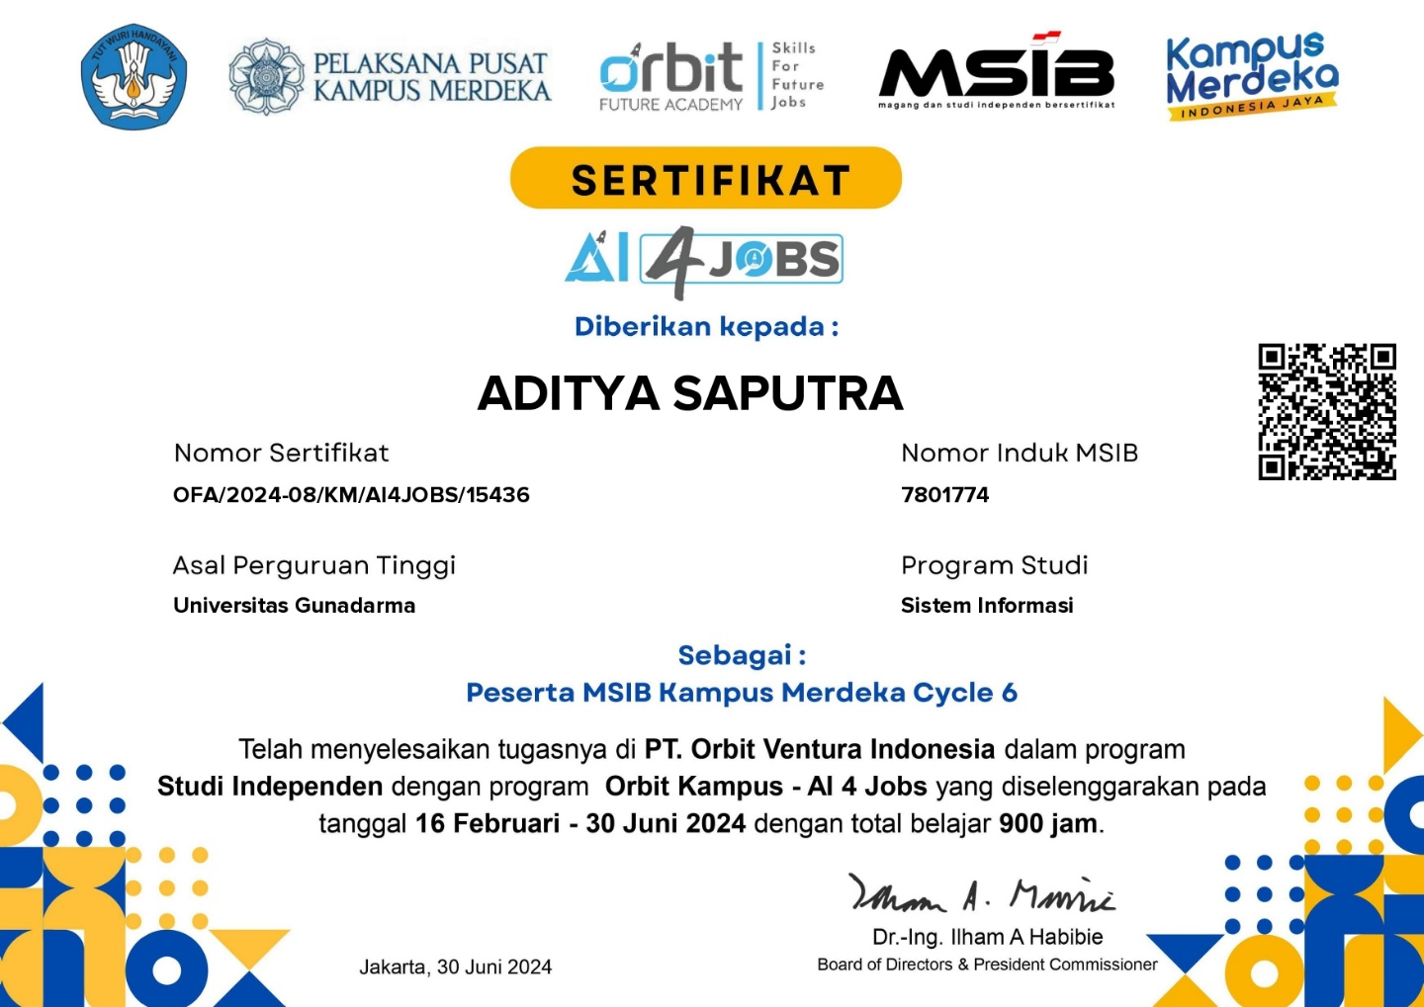
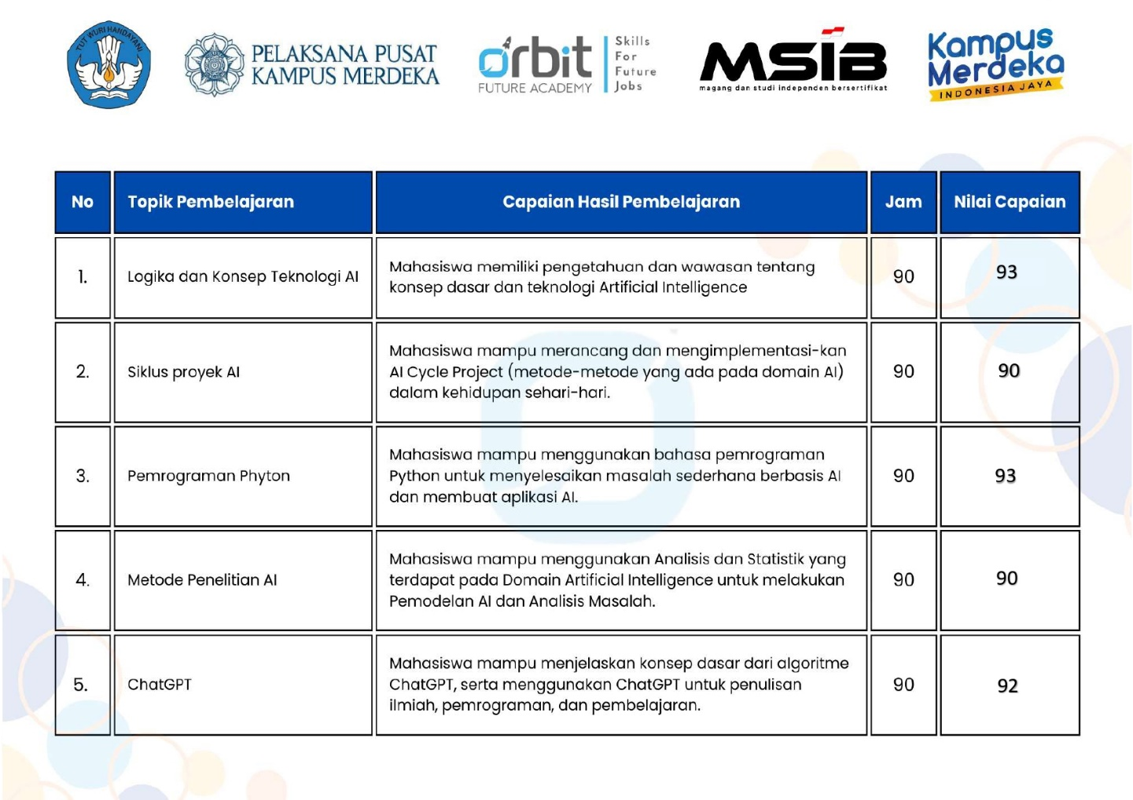
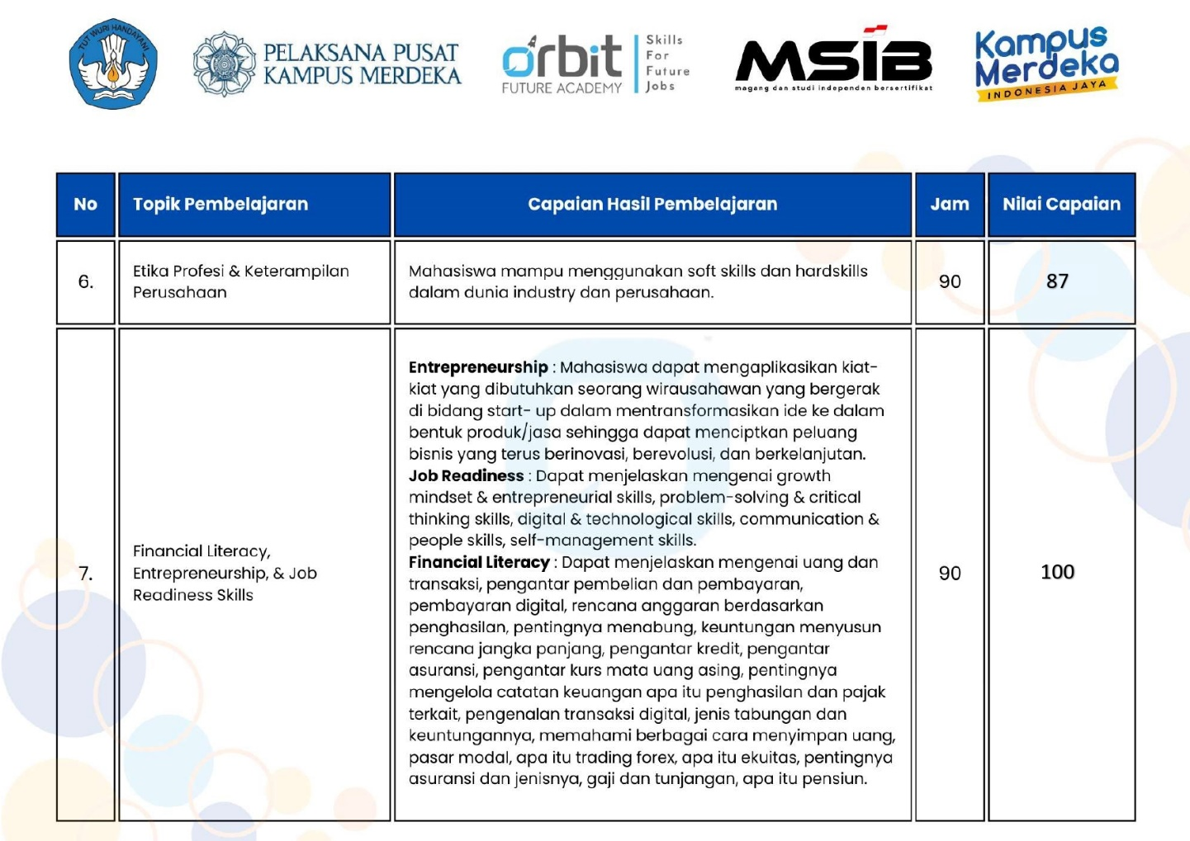
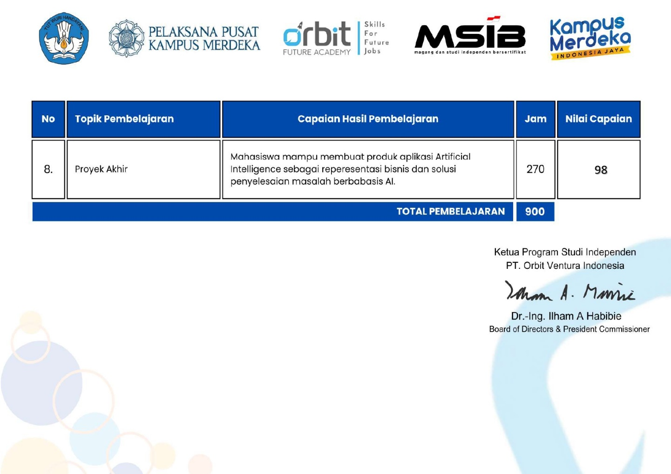
P A G E 0 5
Kampus Merdeka: Orbit Kampus - Artificial Intelligence 4 Jobs

Slide 7
CONTACT ME
Phone Email
Address
LinkedIn
+62895324865054
saputradditya@gmail.com
Kota Bekasi, Jawa Barat
http://www.linkedin.com/in/aditya-saputra-603951274

Slide 8
